Slide 1
Aromatic Chemistry

Slide 2
Index
Hydrocarbon basics
Circles?!

Slide 3
Hydrocarbon basics
Some extra information!
Carbon ( C ) & Hydrogen ( H )
Alkanes, Alkenes, Alkynes
Click for some more basics!
Go to the next part!

Slide 4
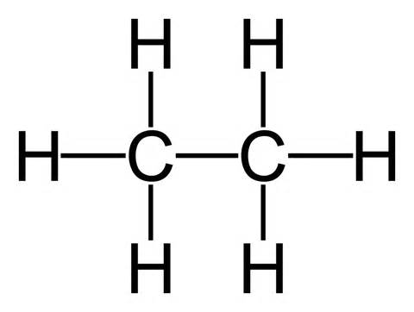
Hydrocarbon basics: Alkanes
Amount of C → *2 +2 → Amount of H
Alkane → single bond → stable bond
Name of the molecule | Formula
Methane | CH₄
Ethane | C₂H₆
Propane | C₃H₈
Buthane | C₄H₁₀
Pentane | C₅H₁₂
Hexane | C₆H₁₄
Heptane | C₇H₁₆
Octane | C₈H₁₈
Nonane | C₉H₂₀
Decane | C₁₀H₂₂
Ethane (C₂H₆)

Slide 5
Hydrocarbon basics: Alkenes
Alkene → double bond → less stable bond
For every double bond → -2 H
No methene!
Name changes depending on where the double bond is!
Name of the molecule | Formula
Ethene | C₂H₄
Propene | C₃H₆
Buthene | C₄H₈
Pentene | C₅H₁₀
Hexene | C₆H₁₂
Heptene | C₇H₁₄
Octene | C₈H₁₆
Nonene | C₉H₁₈
Decene | C₁₀H₂₀
3-octene, double bond is in third place

Slide 6
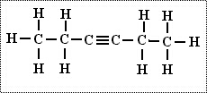
Hydrocarbon basics: Alkynes
Alkynes → triple bond → the least stable bond
For every triple bond -4 H
No metyne!
Name changes depending on where the triple bond is.
Name of the molecule | Formula
Ethyne | C₂H₂
Propyne | C₃H4
Buthyne | C₄H₆
Pentyne | C₅H₈
Hexyne | C₆H₁₀
Heptyne | C₇H₁₂
Octyne | C₈H₁₄
Nonyne | C₉H₁₆
Decyne | C₁₀H₁₈
3-hexyne, triple bond is in the third place

Slide 7
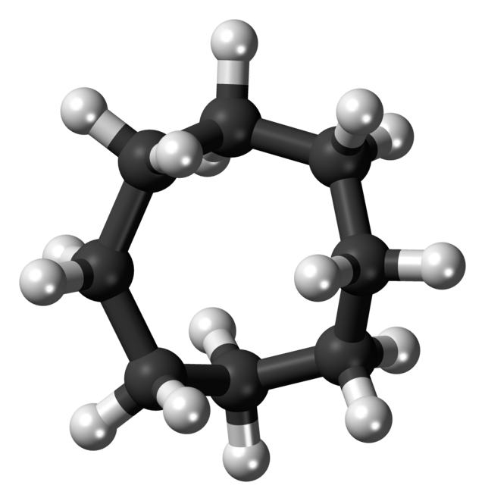
Circles?!
Theory of Kekulé → snake biting its own tail.

Slide 8
Questions
How many carbon atoms are in butane
Which of the following is an alkane?
What is the shape of aromatic molecules?
Why doesn’t methene exist?
Which of the following is the formula of benzene?
How many types of bonds does the benzene have?
Who discovered the structure of benzene.
Notes:
How many carbon atoms are in butane
Which of the following is an alkane?
What is the shape of aromatic molecules?
Why doesn’t methene exist?
Which of the following is the formula of benzene?
How many types of bonds does the benzene have?
Who discovered the structure of benzene.

